Slide 1
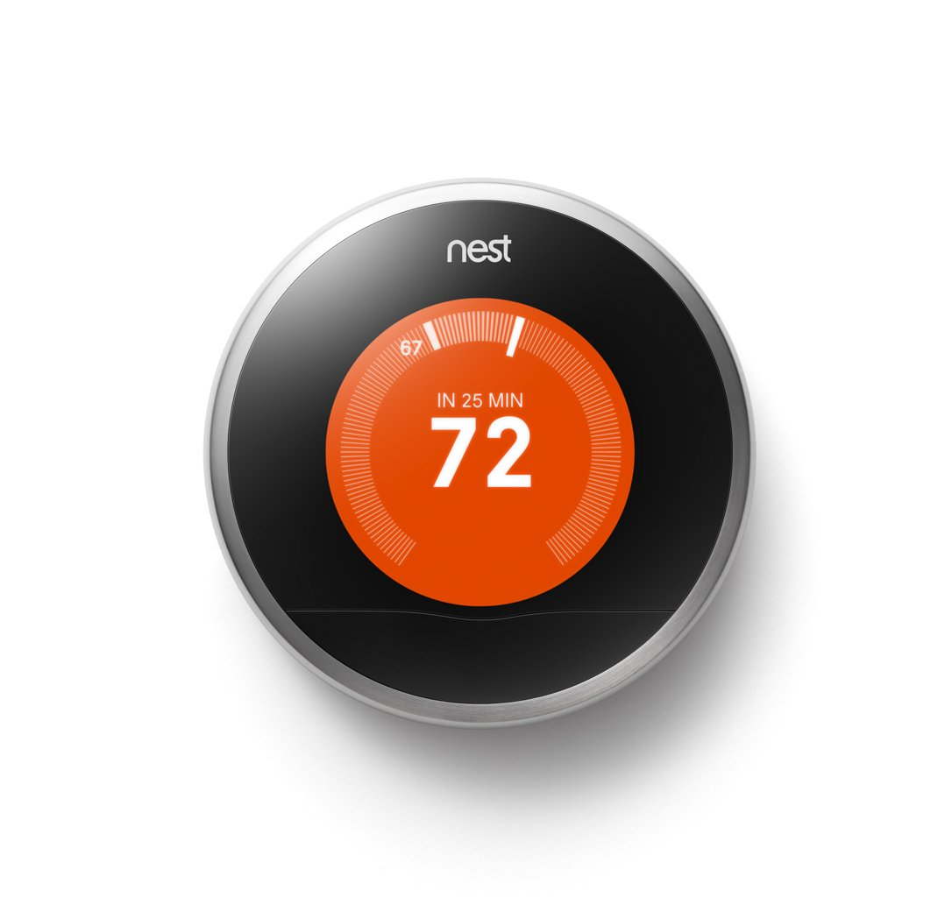
Nest Thermostat
Group 4
Members:
Christopher Donner
Pryambudhi Cahyadi

Slide 2
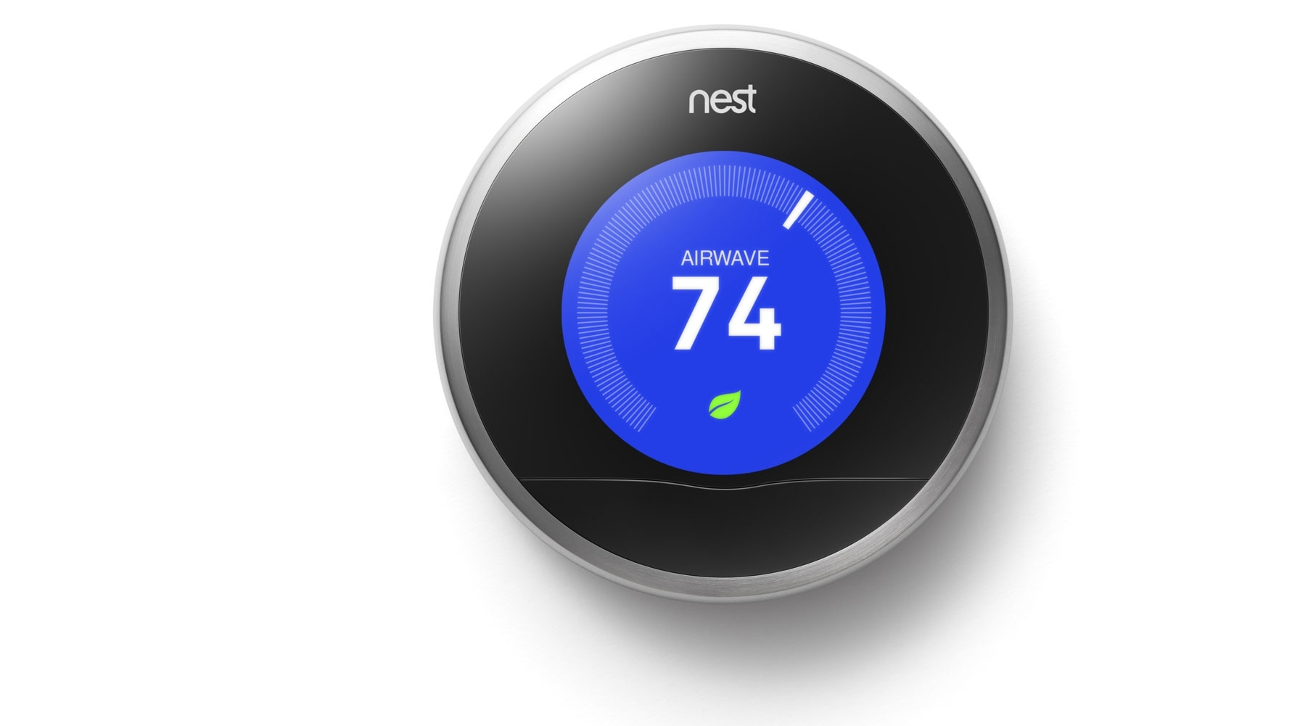
Project Description
Weather forecast and indoor temperature control have been modernized for many years.
The Nest Thermostat is one of the most popular home thermostats on the market today,
On our website, users will be able to enter their location on our website.
This data will be, then, stored in our local storage.
With AJAX calls, users will be able to do the followings from our website:
display weather data based on user location value
display ambient temperature and target temperature from the NEST thermostat
increment or decrement the thermostat target temperature. This must be bound by the actual thermostat limits of min=9 and max=32
chart out the historic data we pull from firebase

Slide 3
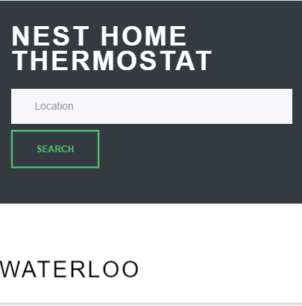
Searching for location
Users will be able to search the temperature in their neighborhood by entering their location in the search box.

Slide 4
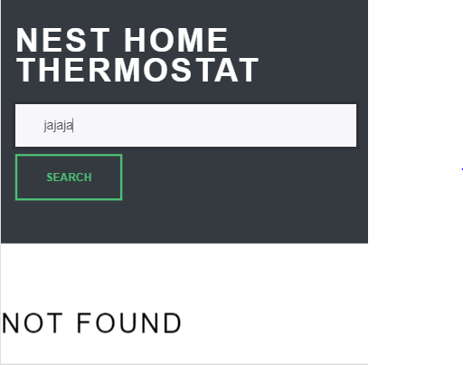
INVALID LOCATION
If users enter invalid location, they will see
NOT FOUND

Slide 5
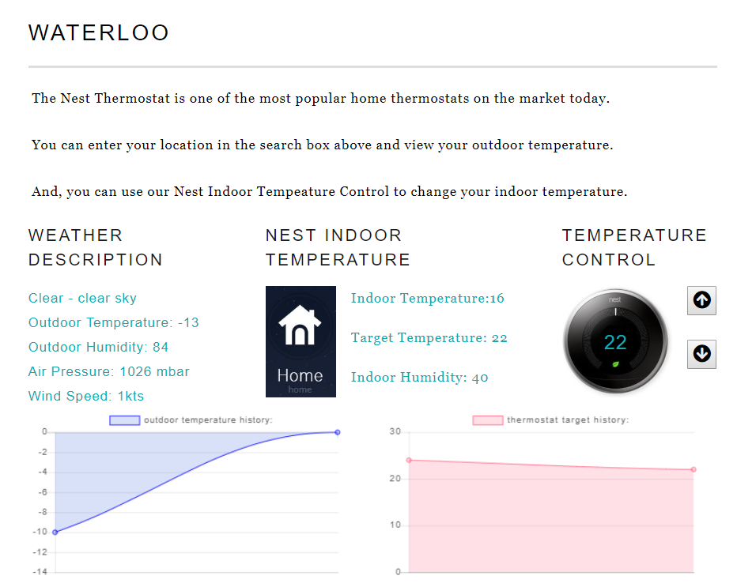
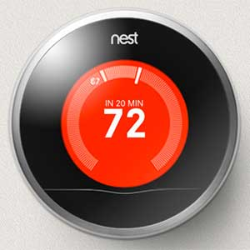
Main Body
The main body of our website consists of:
1
Weather description
2
Nest Indoor temperature
3
Temperature Control
4
Outdoor temperature chart
5
Indoor temperature chart

Slide 6
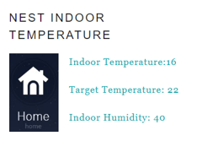
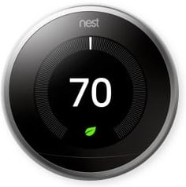

Nest Indoor Temperature Control
Users can see their target temperature in the middle our Nest Thermostat. And, they can change this temperature by clicking the up and down arrow on our website:

Slide 7
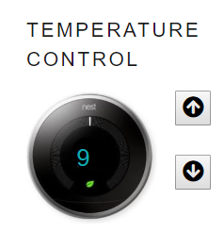
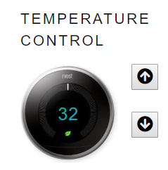
Nest Indoor Temperature Control
For the temperature control, the lowest temperature that can be set is 9.
For the temperature control, the highest temperature that can be set is 32.

Slide 8


Which APIs used on our website
For our project, we are using the weather API from openweathermap and Nest API.
1
2

Slide 9
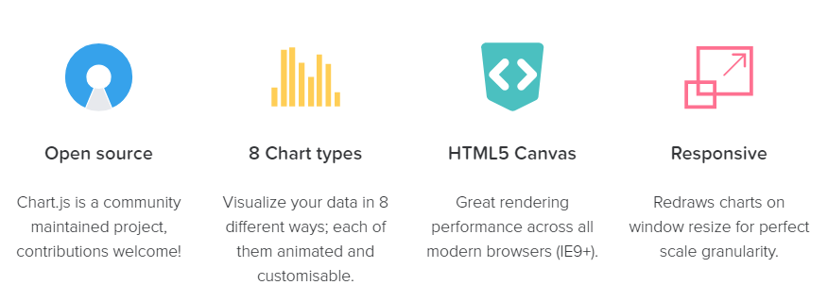
What new technology are we using?
We are very excited that we can incorporate Chart.js into our project by projecting the data we store in our Firebase into a pretty chart.

Slide 10


Our Pseudocode
On load:
check local storage for user.location value
initialize firebase connection
set on child_added trigger for firebase
draw the chart as the firebase data is pushed to a local array
set 300 second polling interval for weather GET and nest GET
if 404 is returned from openweather API on the query call, return error
OpenWeather API returns temperature, wind speed, humidity, main description, sub description
NEST API Poll queries the thermostat for currentTemp and targetTemp and pushes all weather and thermostat data to firebase
Values obtained in the NEST and Weather polls are pushed to the HTML page using JQUERY
This Photo by Unknown Author is licensed under CC BY-NC-ND

Slide 11
Our Pseudocode
On click:
triggers created for thermostat up and down -> on click, local value is incremented and PUT request is sent to NEST API pushing local value to the thermostat
on click is created for the user's location -> on click pulls the value of the form, trims, sets to lower case and calls the weather poll function which will return a Not Found error if a 404 is returned
This Photo by Unknown Author is licensed under CC BY-NC-ND

Slide 12

Feature requests:
In our program, we are hard coding the NEST auth token that was obtained via the ARC REST client. It would be nice to implement this within the product:
celsius vs farenheit selector was never coded.
iterate through the nest response to pull all available devices and then store the device ID required. As it stands, this has been hardcoded based on the initial response.
have images (sun, cloud, snow, rain, etc) that display based on the weather main description that is returned
This Photo by Unknown Author is licensed under CC BY-NC-ND

Slide 13

Pain Points: CORS error
The NEST API requests were returning a CORS error that took me a long time to overcome - if we couldn't figure this out, the project would stop
The NEST API PUT request was challenging. With the GET, I was passing the auth token in the URL but with the PUT I had to figure out how to pass this in the header. After correcting the 401 issue, I was getting a HTTP 400 until I stringified my JSON payload.
I initially had some trouble with getting the charts to display any data because of where in the app I was calling them, which is why they were moved to the database on.child_add.
This Photo by Unknown Author is licensed under CC BY-NC-ND

Slide 14
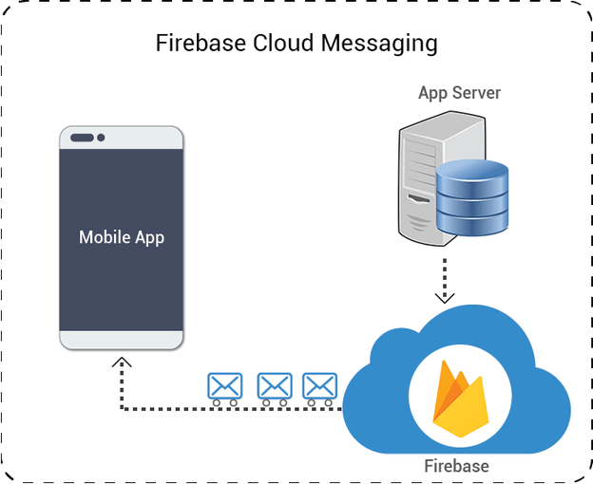
Pain Points: Performance Issue
We had a performance issue when we first finished our project due to the chart being store in the Firebase.
This Photo by Unknown Author is licensed under CC BY-NC-ND

Slide 15


Q & A
Visit our website
Nest Indoor console

